Slide 1
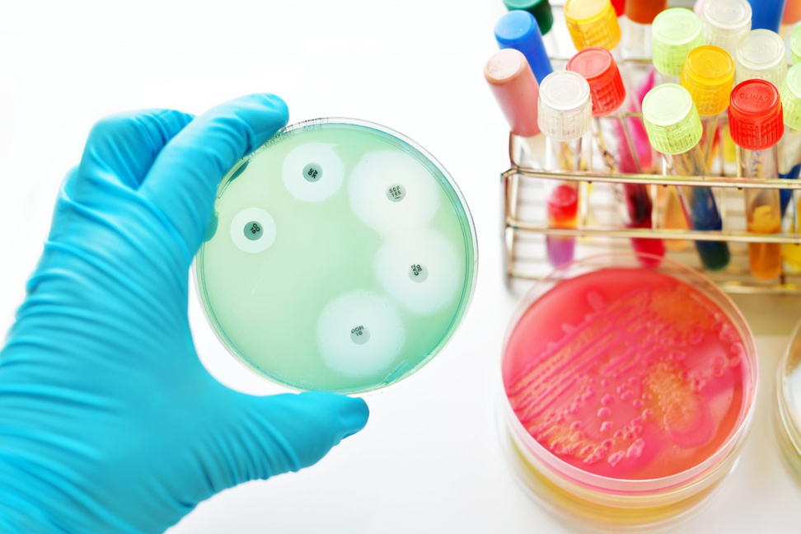
UNIVERSITY OF BASRAH / COLLEGE OF SCIENCE
M.SC.LECTURE 3
ANTIMICROBIAL SUSCEPTIBILITY TEST
Department of Pathological Analyses
Presented by Prof.Dr. Saad S. Mahdi Al-Amaradi Al-Amara

Slide 2

Antibiotic sensitivity
is a term used to describe the susceptibility of bacteria to antibiotics. Antibiotic susceptibility testing (AST) is usually carried out to determine which antibiotic will be most successful in treating a bacterial infection in vivo. Some antibiotics actually kill the bacteria (bactericidal), whereas others merely prevent the bacteria from multiplying (bacteriostatic).

Slide 3
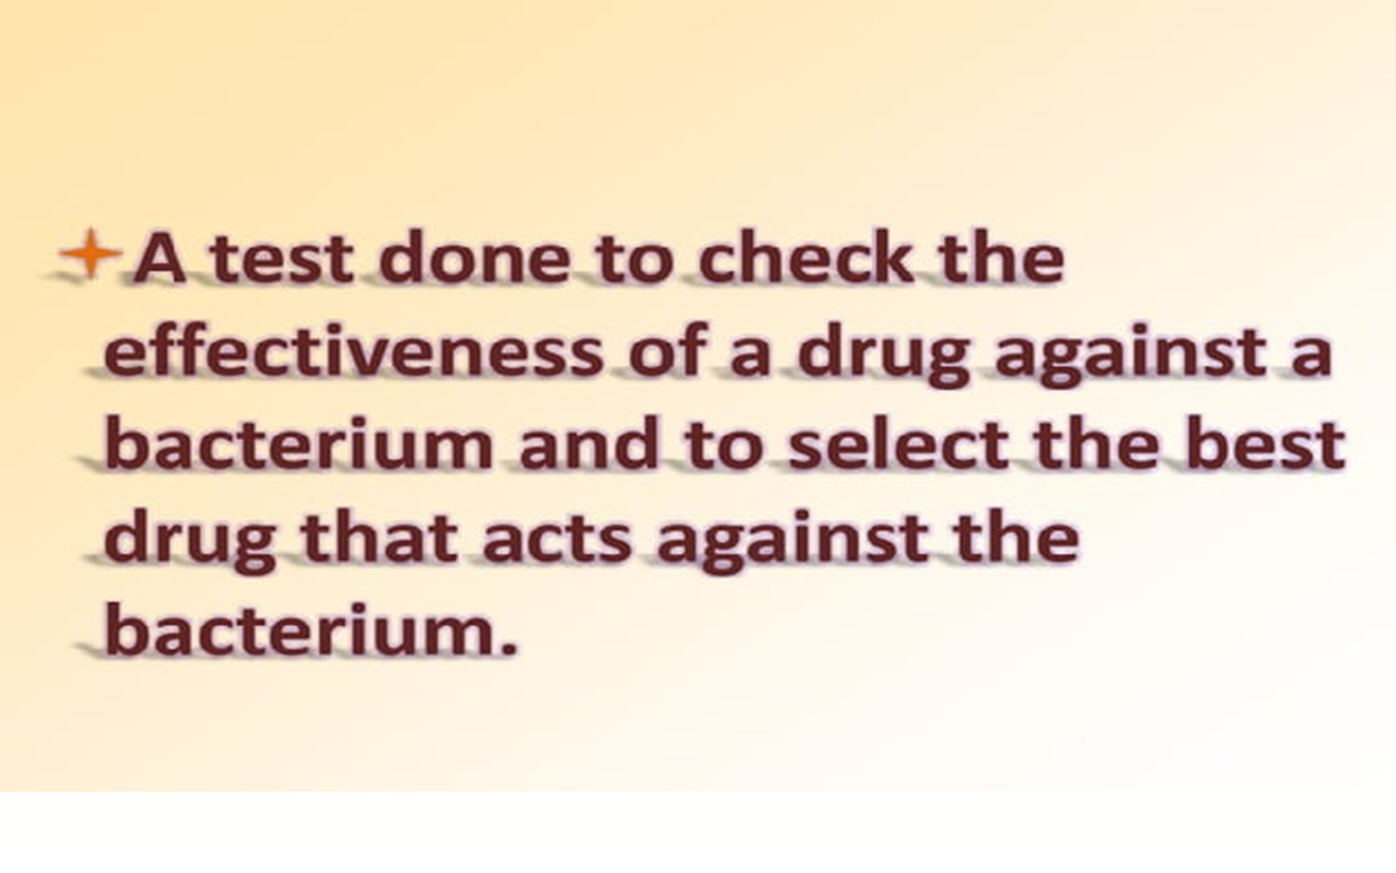

Slide 4


Slide 5
There are multiple methods and techniques available for performing antibiotic susceptibility testing:
  Disc diffusion method (Kirby-Bauer method) : Antibiotic discs are placed on an agar plate with bacteria. The zone of inhibition around each disc is measured and compared to interpretive criteria.
  Broth microdilution method : Serial dilutions of antibiotics are prepared in microtiter plates. Bacterial suspension is added, and the MIC is determined as the lowest concentration inhibiting visible growth (Minimum Inhibitory Concentrations (MIC).

Slide 6
There are multiple methods and techniques available for performing antibiotic susceptibility testing:
  Etest method : Strips with a gradient of antibiotic concentrations are placed on agar plates (MIC strips (Etest))
  A﻿utomated systems: Bacterial growth or inhibition is measured using optical or colorimetric methods, with results interpreted by software.
  Molecular methods : PCR or DNA sequencing detects specific resistance genes or mutations.

Slide 7
The principles of antibiotic susceptibility testing are based on the assessment of the ability of antibiotics to inhibit the growth of bacteria or kill them.
  A standardized inoculum of bacteria (usually 0.5Mcf) is dabbed onto the surface of a dish of Mueller-Hinton (MH) agar
  Discs impregnated with antimicrobial agents are placed on the agar.
  After overnight incubation, the diameter of the zone of inhibition is measured around each disc.
  By referring to the tables of the CLSI standard / EUCAST, we obtain a qualitative report of sensitive (S), intermediate (I) or resistan (R).

Slide 8
The principles of antibiotic susceptibility testing are based on the assessment of the ability of antibiotics to inhibit the growth of bacteria or kill them.
  A standardized inoculum of bacteria (usually 0.5Mcf) is dabbed onto the surface of a dish of Mueller-Hinton (MH) agar
  Discs impregnated with antimicrobial agents are placed on the agar.
  After overnight incubation, the diameter of the zone of inhibition is measured around each disc.
  By referring to the tables of the CLSI standard / EUCAST, we obtain a qualitative report of sensitive (S), intermediate (I) or resistan (R).

Slide 9
The medium used for the majority of bacterial species is Mueller-Hinton agar (plus 5% blood for fastidious germs) :
  It shows acceptable lot-to-lot reproducibility for susceptibility testing.
  It is low in inhibitors which affect sulfonamide, trimethoprim and tetracycline susceptibility test results.
  It supports satisfactory growth of most pathogens.
  A large amount of data and experience has been collected on sensitivity tests carried out with this medium.
  The culture medium must allow the growth of many bacteria and it must not contain antibiotic inhibitors :
  A pH too acidic increases the activity of ß-lactams, an alkaline medium favors aminoglycosides and macrolides, it must be between 7.2 and 7.4, a value which allows good bacterial growth and which achieves a compromise for the activity of antibiotics.
  The calcium and magnesium content must be controlled, because excess divalent cations (Ca2+, Mg2+) inhibit the action of polymyxins.

Slide 10
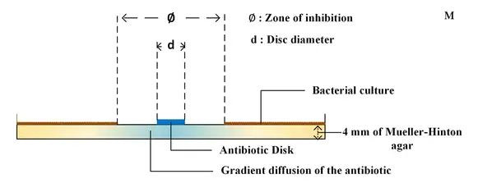
Disc diffusion method (Kirby-Bauer meth﻿od)
  Small filter paper disks containing antibiotics are placed onto a plate upon which bacteria are growing. The antibiotic diffuses from the disk into the agar . If the bacteria are sensitive to the antibiotic, a clear ring, or zone of inhibition, is seen around the disk indicating poor growth. Using special comparators that interpret the diameter of the zones of inhibition, consequently the organism can be described as resistant, intermediate, or sensitive. Tables are used to determine the breakpoint for each drug.

Slide 11
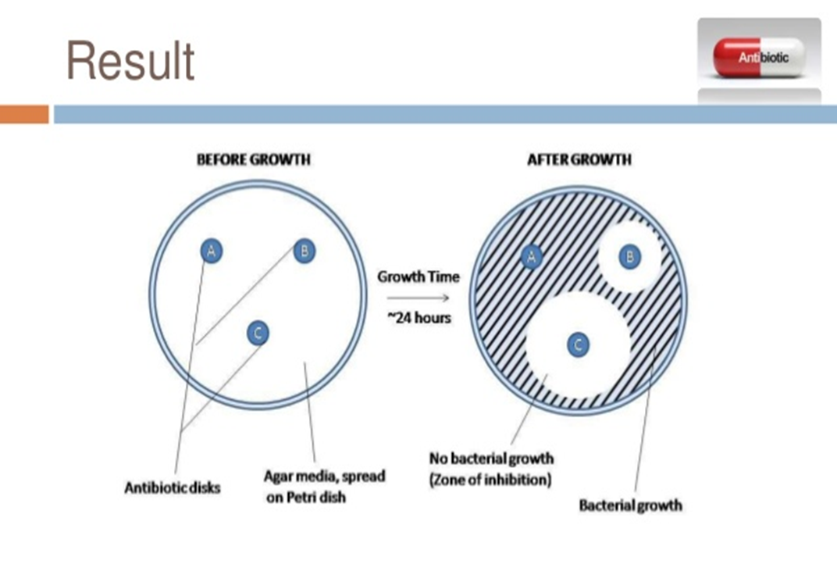
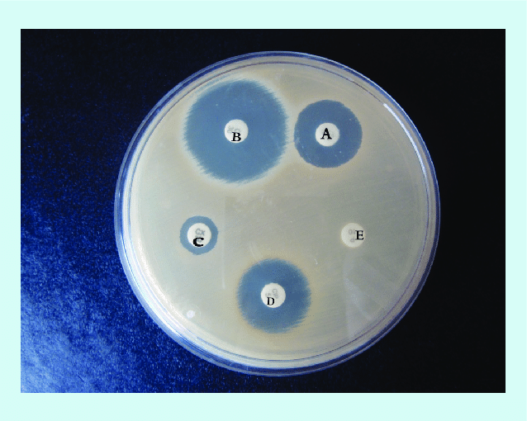

Slide 12
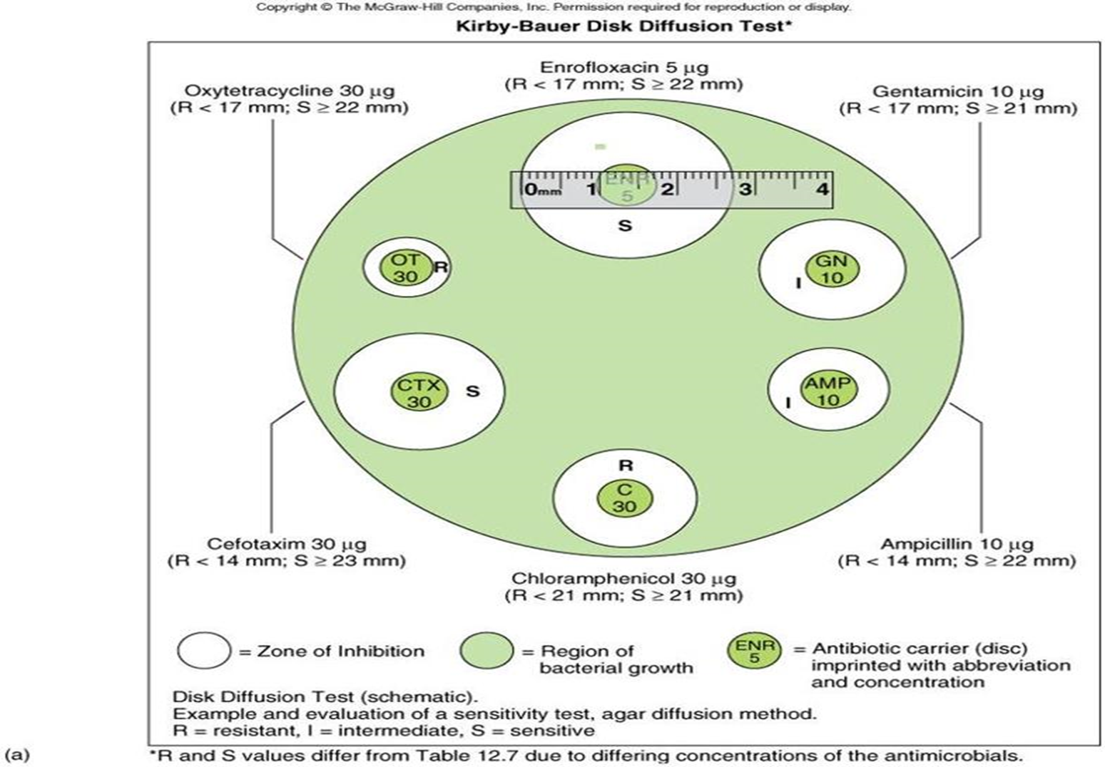

Slide 13
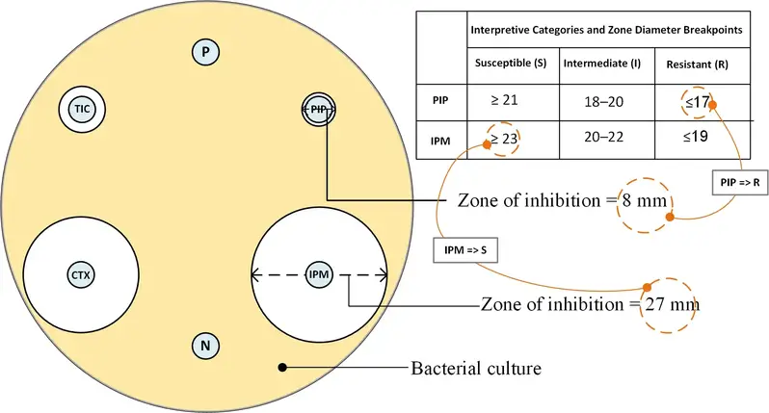

Slide 14
Broth microdilution method
1.Number sterile capped test tubes 1 through 9. All of the following steps are carried out using aseptic technique.
2.Add 2.0 ml of tetracycline solution (100 ug/ml) to the first tube. Add 1.0 ml of sterile broth to all other tubes.
3.Transfer 1.0 ml from the first tube to the second tube.
4.Using a separate pipette, mix the contents of this tube and transfer 1.0 ml to the third tube.
5.Continue dilutions in this manner to tube number 8, being certain to change pipettes between tubes to prevent carryover of antibiotic on the external surface of the pipette.
Broth microdilution method
6.Remove 1.0 ml from tube 8 and discard it. The ninth tube, which serves as a control, receives no tetracycline.
7.Suspend to an appropriate turbidity several colonies of the culture to be tested in 5.0 ml of Mueller-Hinton broth to give a slightly turbid suspension.
8.Dilute this suspension by aseptically pipetting 0.2 ml of the suspension into 40 ml of Mueller-Hinton broth.
9.Add 1.0 ml of the diluted culture suspension to each of the tubes. The final concentration of tetracycline is now one-half of the original concentration in each tube.
  10.Incubate all tubes at 35oC overnight.
  11.Examine tubes for visible signs of bacterial growth. The highest dilution without growth is the minimal inhibitory concentration (MIC).

Slide 15
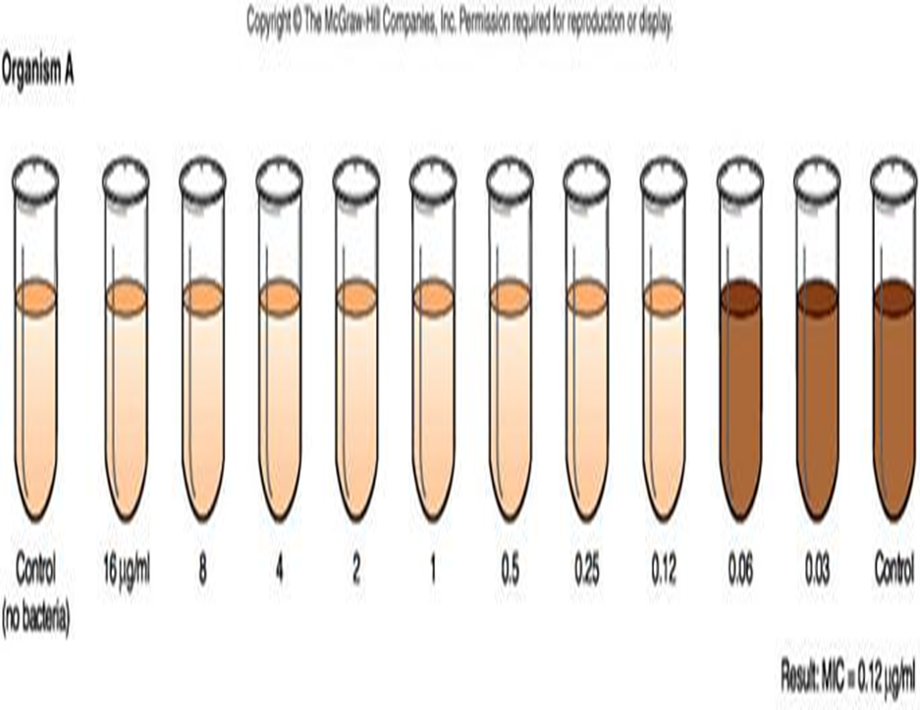
Broth microdilution method
6.Remove 1.0 ml from tube 8 and discard it. The ninth tube, which serves as a control, receives no tetracycline.
7.Suspend to an appropriate turbidity several colonies of the culture to be tested in 5.0 ml of Mueller-Hinton broth to give a slightly turbid suspension.
8.Dilute this suspension by aseptically pipetting 0.2 ml of the suspension into 40 ml of Mueller-Hinton broth.
9.Add 1.0 ml of the diluted culture suspension to each of the tubes. The final concentration of tetracycline is now one-half of the original concentration in each tube.
10.Incubate all tubes at 35oC overnight.
11.Examine tubes for visible signs of bacterial growth. The highest dilution without growth is the minimal inhibitory concentration (MIC).

Slide 16
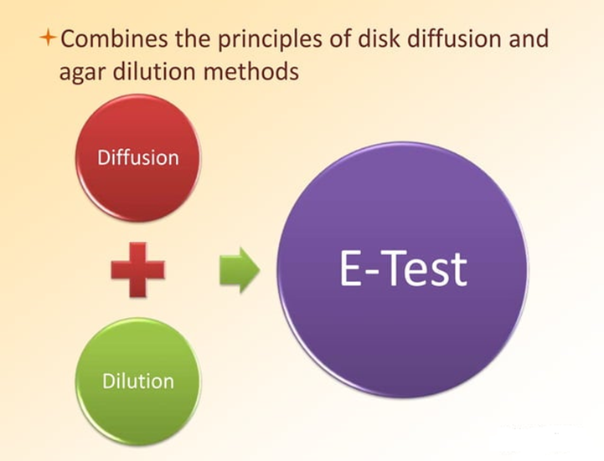
Etest method
The Epsilometer test (usually abbreviated Etest):
is a laboratory test used to determine whether or not a bacterium is susceptible to an antibiotic.
  The Etest utilizes a rectangular strip that has been impregnated with the drug to be studied.
  A lawn of bacteria is inoculated onto the surface an agar plate and the Etest strip is laid on top; the drug diffuses out into the agar, producing an exponential gradient of the drug to be tested.
  There is an exponential scale printed on the strip. After 24 hours of incubation, an elliptical zone of inhibition is produced and the point at which the ellipse meets the strip gives a reading for the (MIC) of the drug.

Slide 17
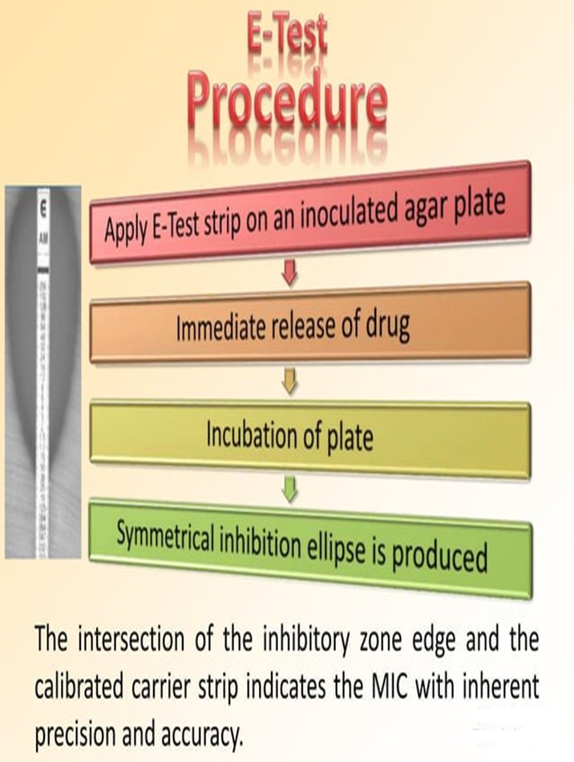
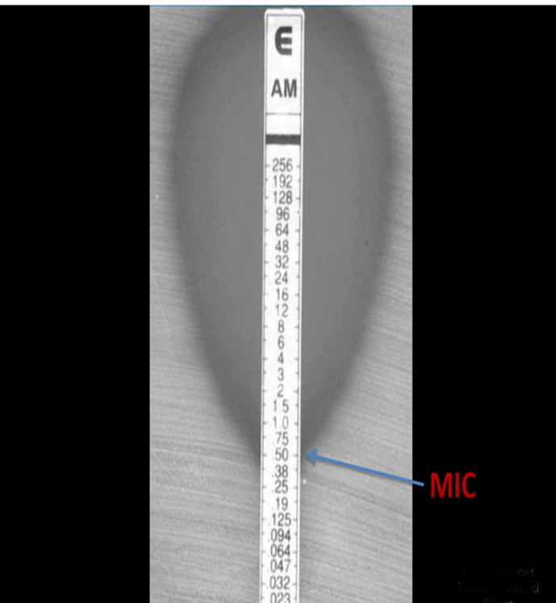

Slide 18
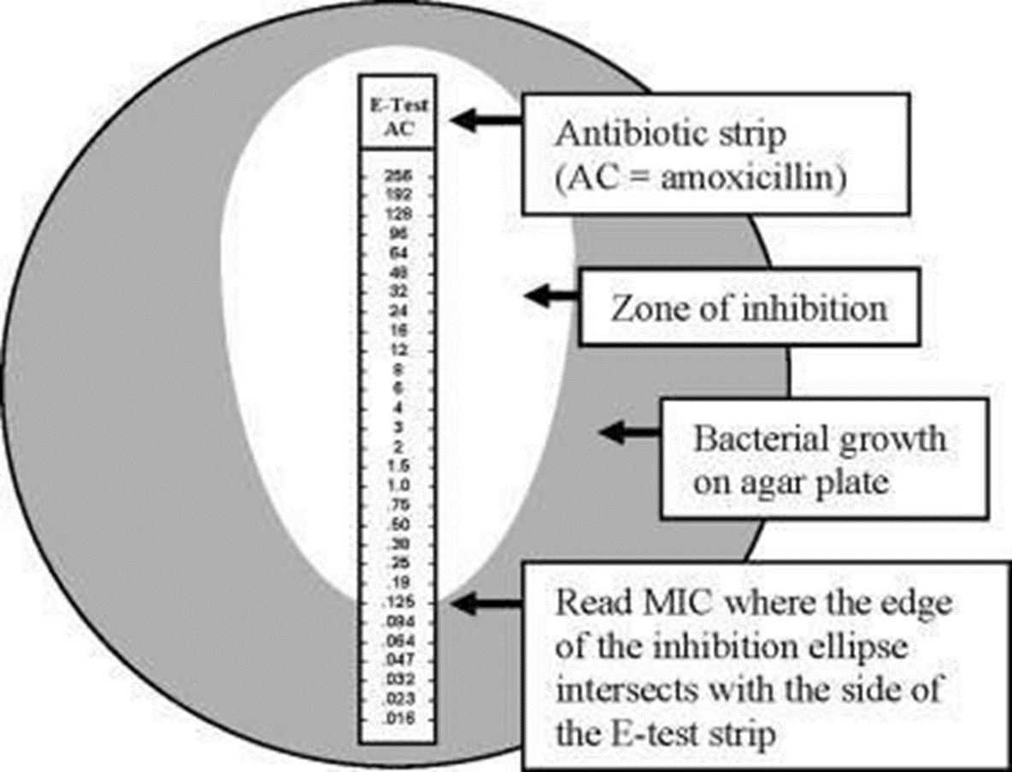

Slide 19
THANK YOU

